Slide 1
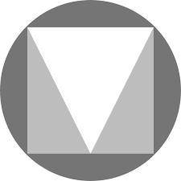
Decoding
Material Design
Ritwik Raha
“Let’s Talk Web”
22-06-19
ritwik@tcfindia.in

Slide 2

About Me
Co-Founder, CEO at The Code Foundation
Developer, Designer, UX Enthusiast
Linkedin: www.linkedin.com/in/ritwik-raha/
Github: github.com/ritwikraha
Behance: www.behance.net/ritwikraha
Dribble: https://dribbble.com/RitwikR

Slide 3
What this fuss about Design Thinking?
“Design thinking is a human-centered approach to innovation that draws from the designer's toolkit to integrate the needs of people, the possibilities of technology, and the requirements for business success.”
— Tim Brown, CEO of IDEO

Slide 4
Let’s get Materialistic now
Material is a design system ,backed by open-source code, that helps teams build high-quality digital experiences
-Folks at Google

Slide 5
So what makes it Material?
Inspired from studying paper and ink
Bold Intentional and Graphic
Meaningful Motion

Slide 6
I’ll do you one better- “Why Material”
Helps ideas scale to a unified system.
Provides clear guidelines for developing apps android , web and ios
Lets you craft experiences that are responsive and applications that are both beautiful and usable

Slide 7
Know thy System
Flat design is a minimalistic design approach that emphasises usability. It features clean, open space, crisp edges, bright colours and two-dimensional illustrations.

Slide 8
The Objects, they live in a harsh world!
They can:
Shrink
Transform
Rotate
Animate
Elevate(only 1 dp)
But cannot:
Bend
Occupy the same position
Display non uniformity

Slide 9
COLORS
FONTS
ICONS
https://material.io/design/
Hierarchical
Legible
Expressive
Neutral
Sans Serif
Passive
Universal
Minimal
System-icons & Product-Icons

Slide 10
“Do not go gentle into that good night”

Slide 11
Some real examples

Slide 12
A Little Parting Gift
Free UI kits (.xd and .psd)
UX books to kickstart
Mockups for presentations
A general Assets library
bit.ly/2GhPXCM

Slide 13
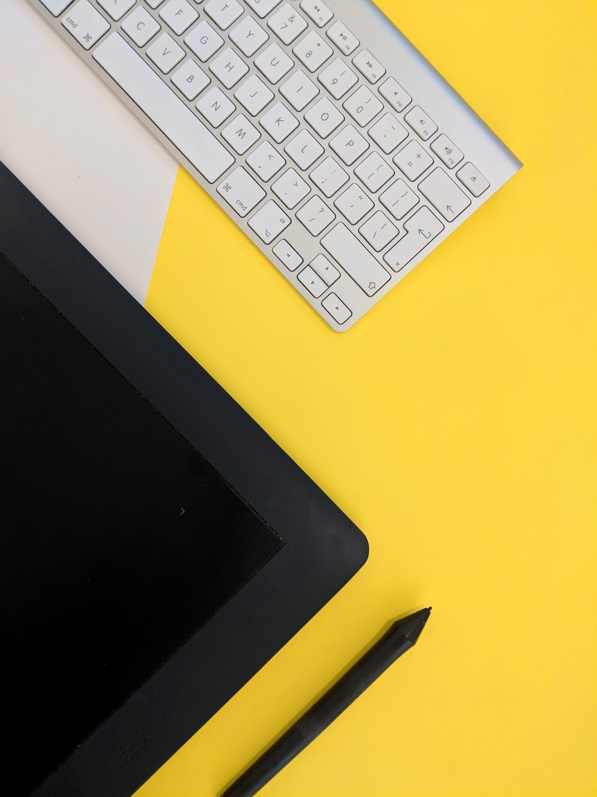
THANK YOU

